Slide 1
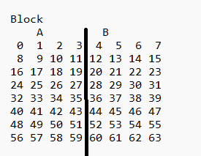
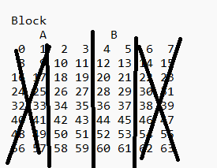
Last week
Successfull detection
Enhanced performance by limiting number of used pixels

Slide 2
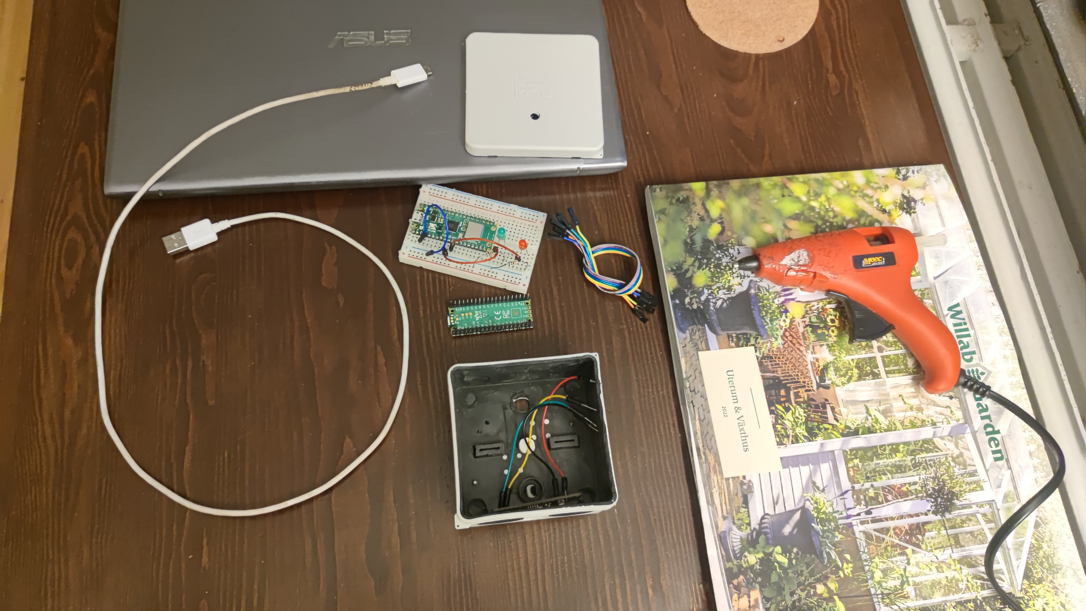
Last week
Assembled hardware

Slide 3
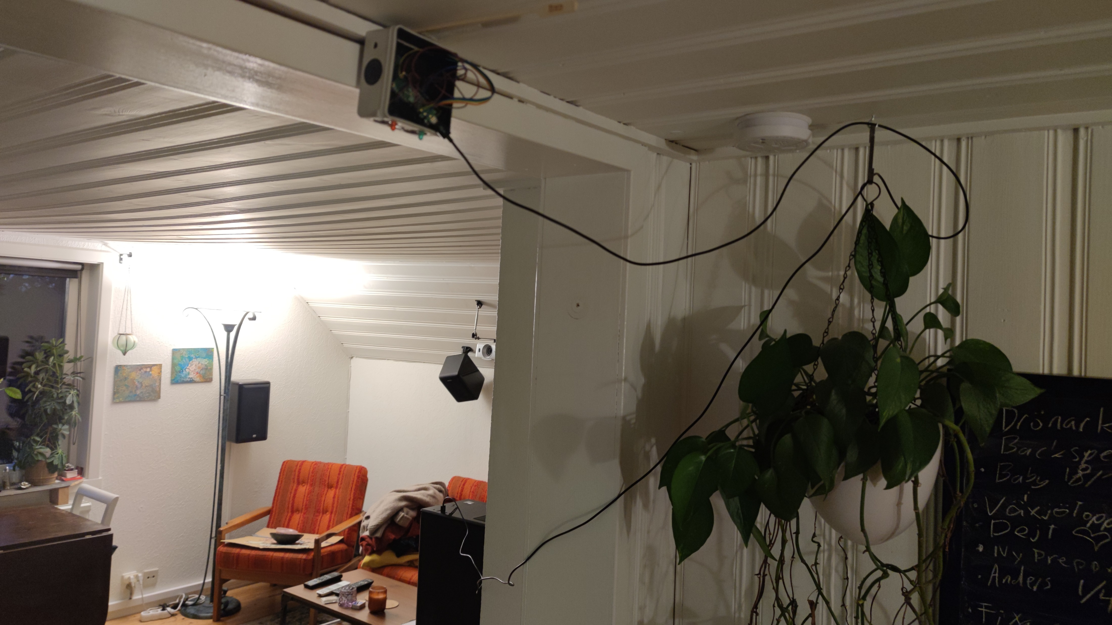
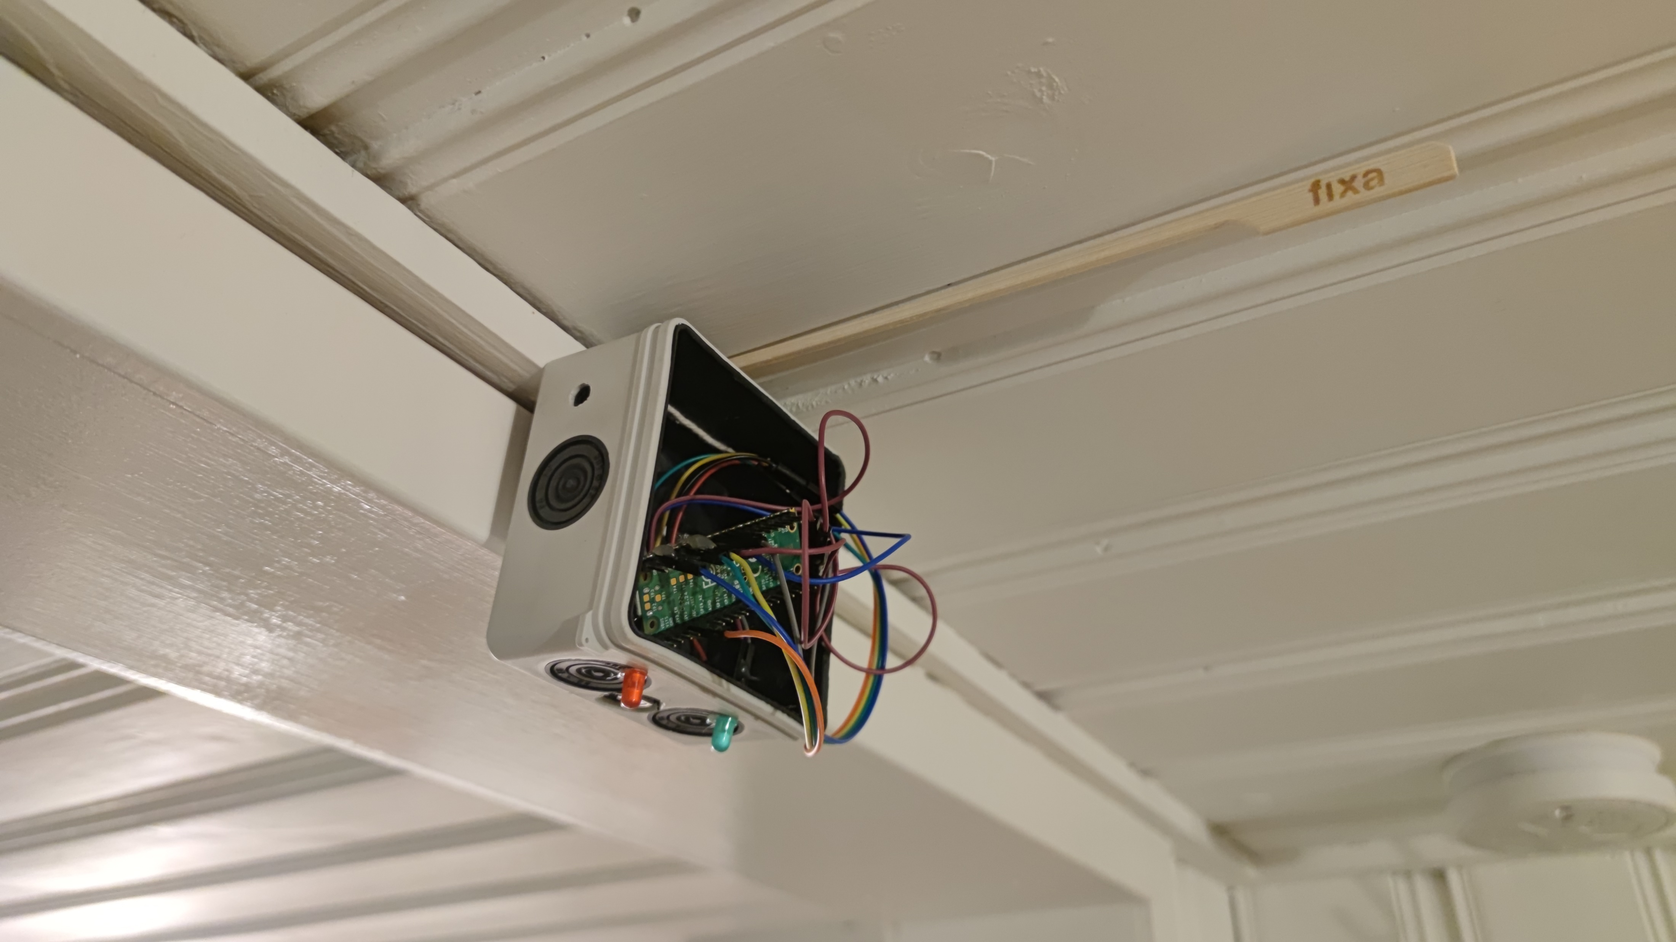
This week
Testing and calibrating
Begin looking at WiFi and sending
data to cloud

